Slide 1

2017 Stack Overflow Survey Analysis
Jerry Cheng
Computer Science with data Analysis
Dr. Bixler
30 January 2018

Slide 2
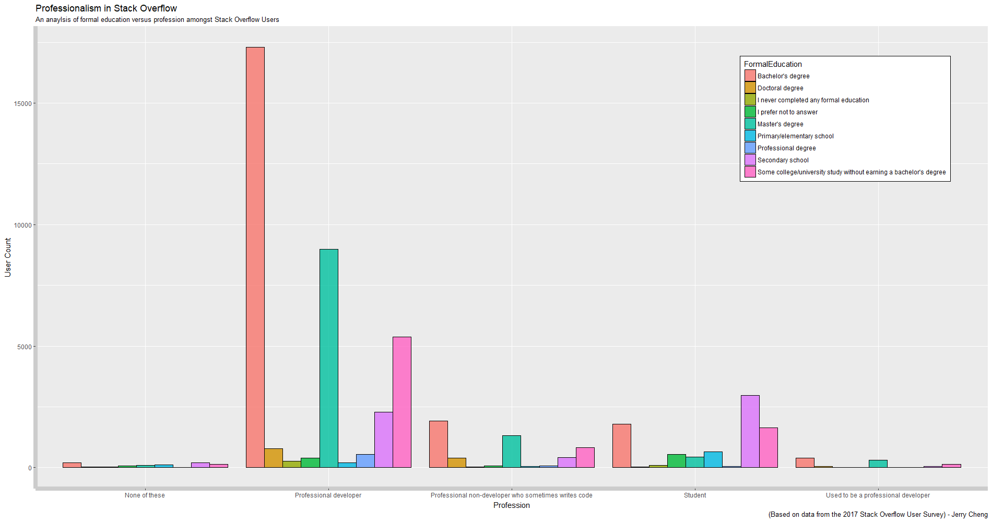

Slide 3
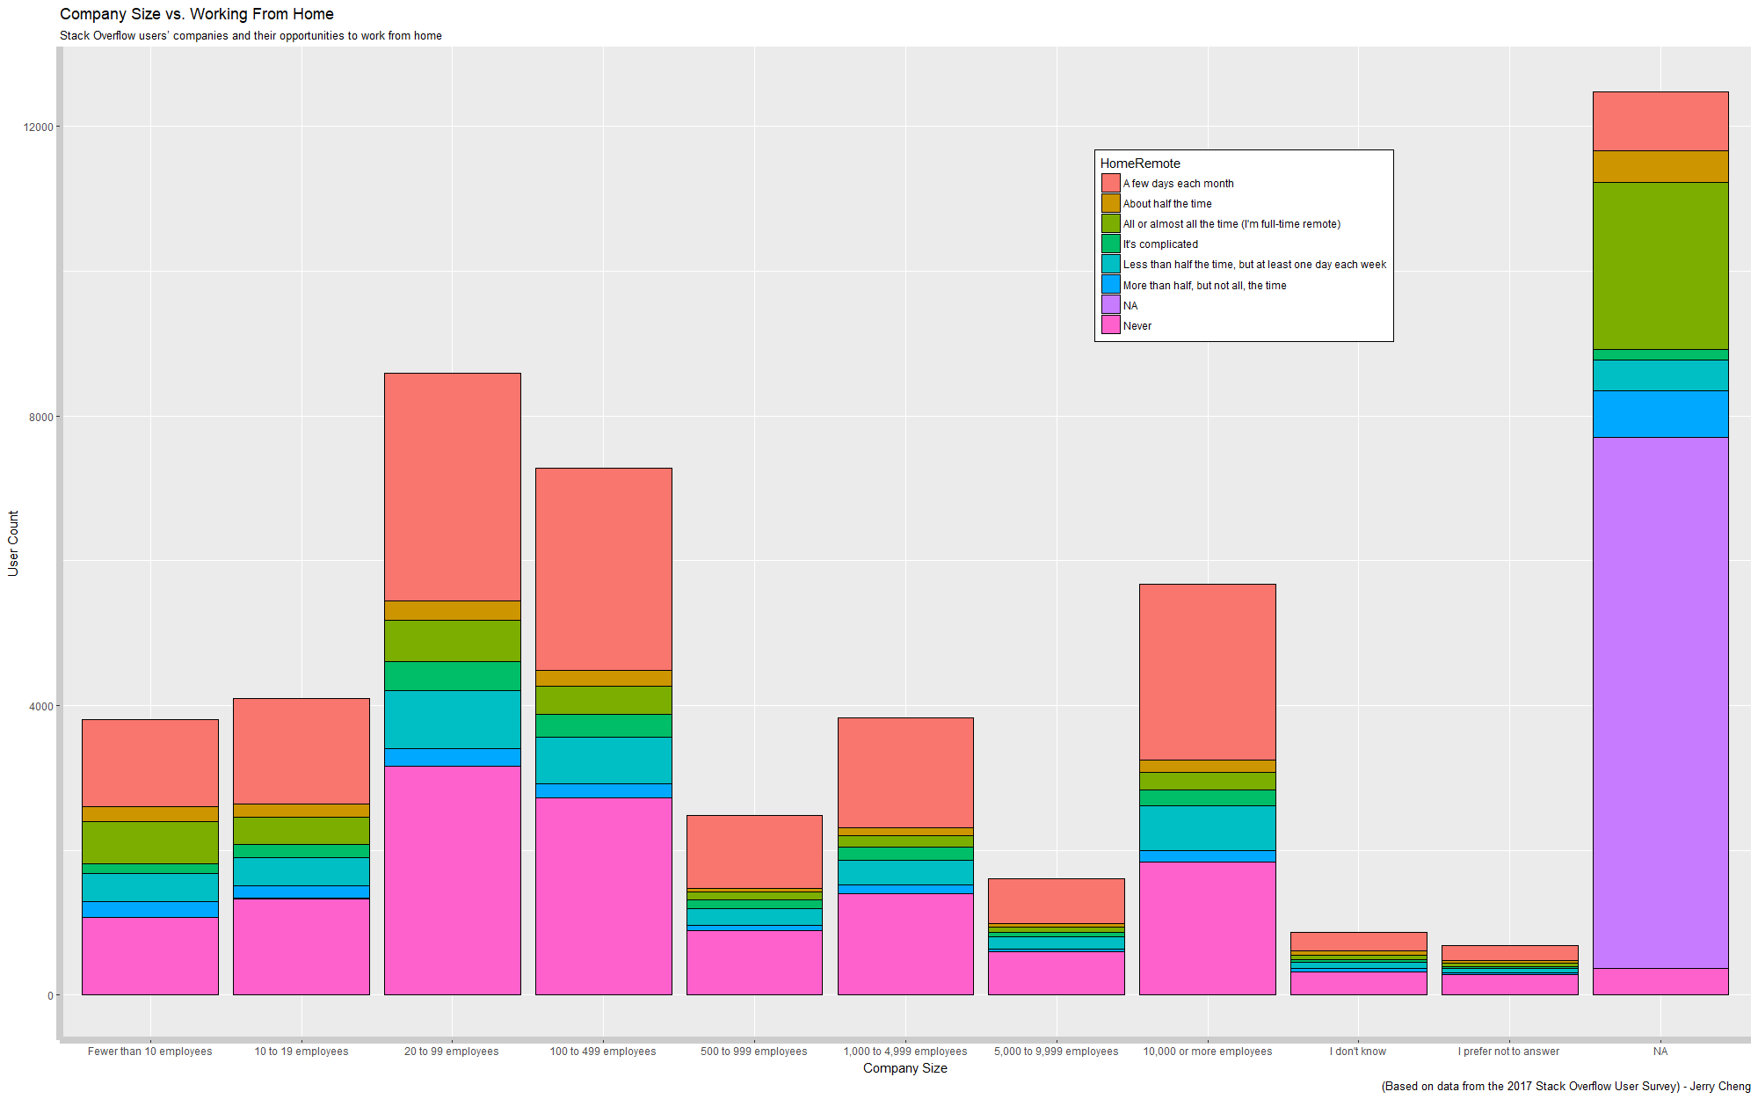

Slide 4
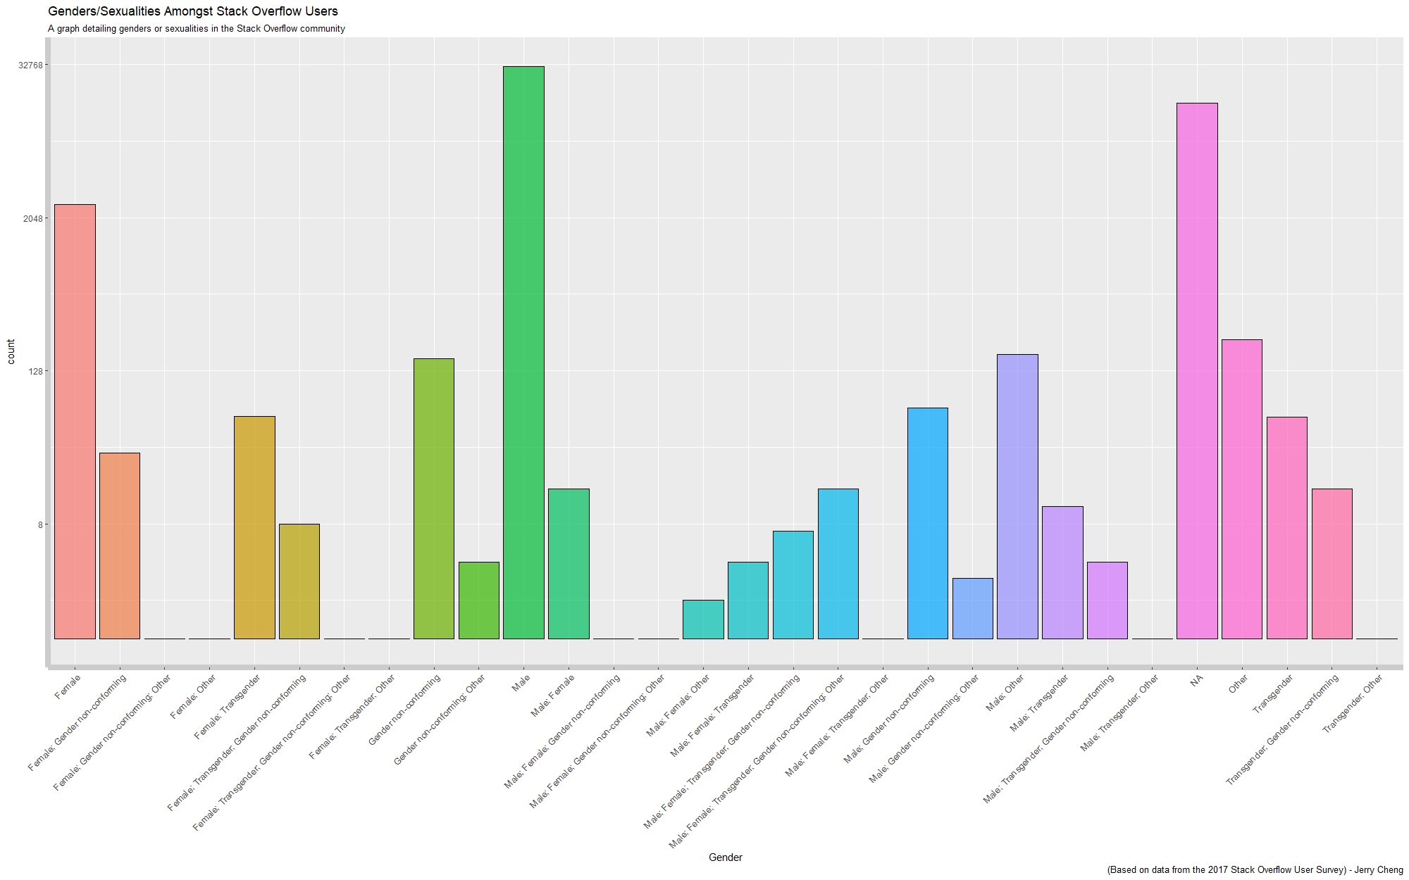

Slide 5
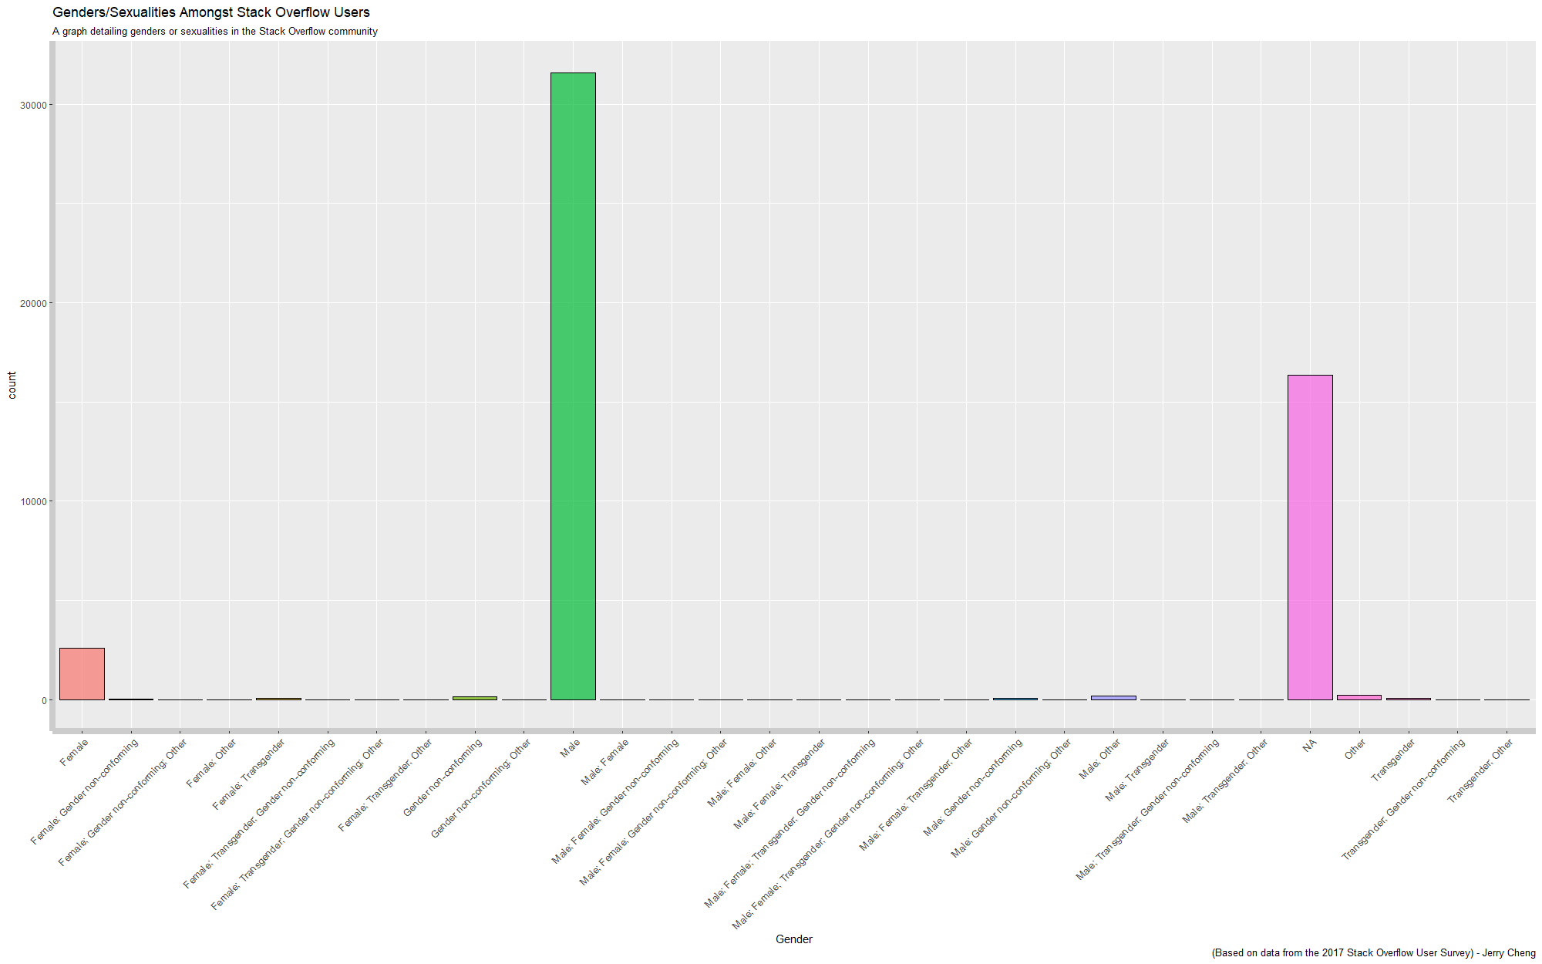

Slide 6
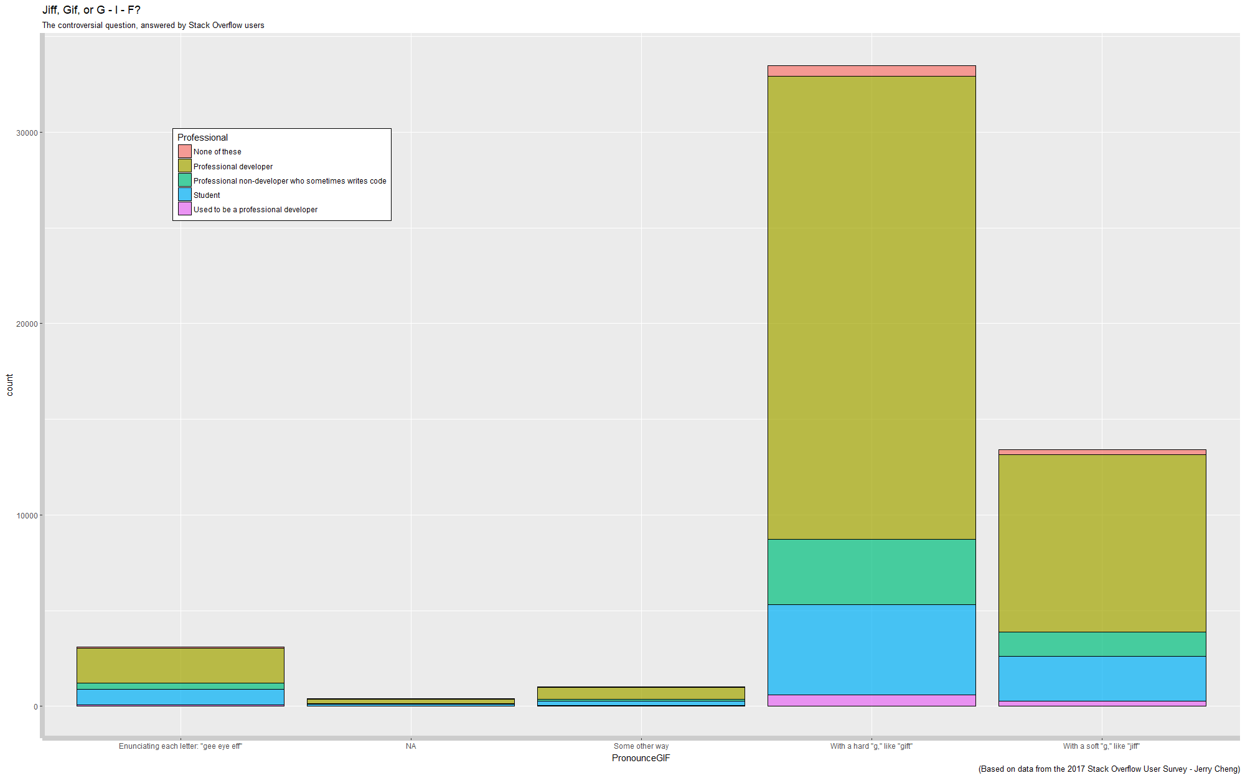

Slide 7
